Slide 1
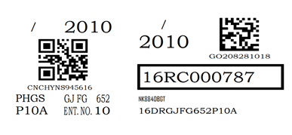


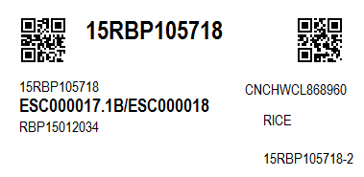
Planting Packet
Planting Stake
Source Packet

Slide 2


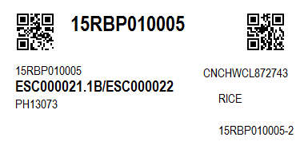
16WEGM5000
16WEFEDTID60P123
16WEGM5000
16WEGM5000
Row Band/ Plant Band/ Pollination Band
New Generation Source Packet

